Slide 1
BloodLife AI: Blood Donation Prediction System Using Machine Learning
CAPSTONE PROJECT
Presented By:
Student Name- Sohail Shaikh
College Name- Karmaveer Adv.Baburao Ganpatrao Thakre College of Engineering
Department- B.E.(Computer)

Slide 2
OUTLINE
Problem Statement
Proposed System/Solution
System Development Approach (Technology Used)
Algorithm & Deployment
Result
Conclusion
Future Scope
References

Slide 3
Problem Statement
Blood banks often face shortages of blood during emergencies.
It is difficult to identify donors who are likely to donate again.
Contacting all registered donors requires significant time and effort.
Donor records are often underutilized.
There is a need for a system that can analyze donor history and support decision-making.

Slide 4
Proposed Solution
Develop a Machine Learning based Blood Donation Prediction System.
Analyze previous donation records of donors.
Predict whether a donor is likely to donate blood again.Help blood banks focus on potential donors.
Improve blood collection efficiency and availability.
Support both individual donor prediction and bulk donor analysis.
Provide insights through dashboards and reports.
Help blood banks focus on potential donors.

Slide 5
System Approach
Technologies Used
Programming Language
Python
Libraries
Pandas
NumPy
Scikit-Learn
User Interface
Streamlit
Development Environment
VS Code
Dataset
Blood Transfusion Service Center Dataset
Model
Logistic Regression

Slide 6
Algorithm & Deployment
Algorithm Used: Logistic Regression
Load blood donation dataset.
Perform data preprocessing.
Split data into training and testing sets.
Train Logistic Regression model.
Save trained model.
Accept donor details as input.
Predict donor behavior.
Display prediction result.
Dataset
↓
Data Preprocessing
↓
Model Training
↓
Logistic Regression
↓
Prediction Engine
↓
Streamlit Dashboard
↓
Result
Deployment:
Train model using Python.
Save model using Pickle.
Create web interface using Streamlit.
Deploy application locally.
Users enter donor information.
System displays prediction instantly.

Slide 7
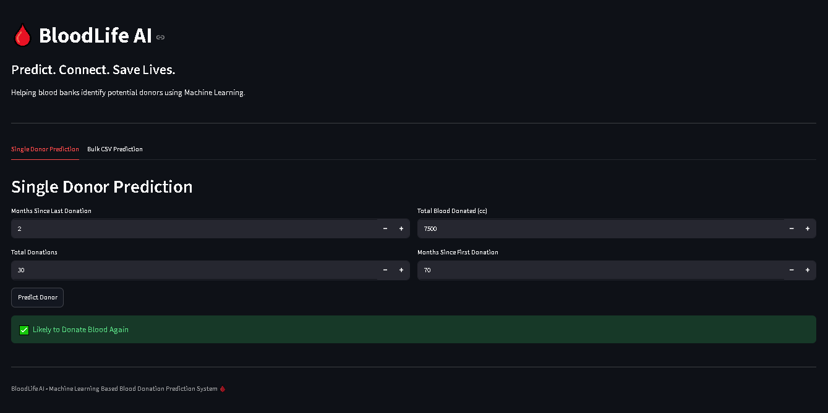
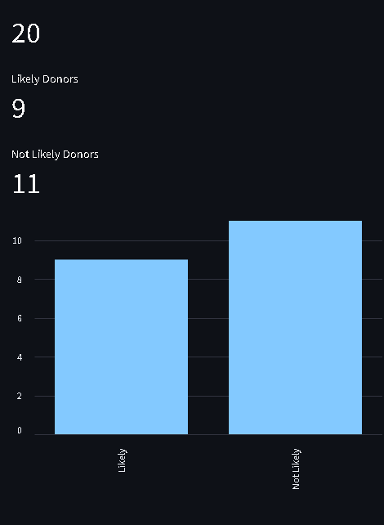
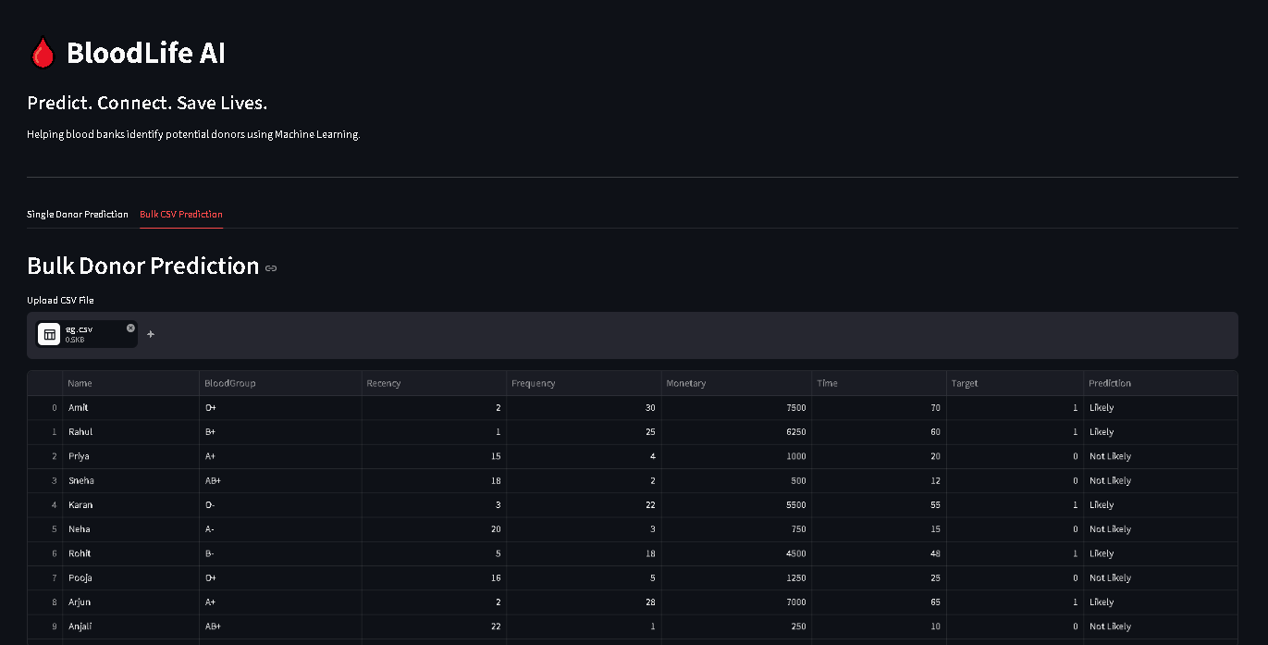
Result
Sample Input:
Month since last donation = 2
Total Blood Donated = 7500
Total Donations = 30
Month since
First Donation = 70
Output:
"Likely to Donate
Blood Again"

Slide 8
Conclusion
Developed a Machine Learning based Blood Donation Prediction System.
Successfully predicts future donor behavior.
Helps blood banks identify potential donors.
Improves blood availability and management.
Provides a simple and effective solution.
Supports both individual and bulk donor analysis.

Slide 9
Future scope
SMS and Email notifications.
Mobile application development.
Hospital and blood bank integration.
Blood group-wise prediction.
Location-based donor recommendations.
Use advanced Machine Learning algorithms for better accuracy.

Slide 10
References
pandas - Python Data Analysis Library pandas – Python
https://pandas.pydata.org
Streamlit • A faster way to build and share data apps
Welcome to Python.org Python.org https://www.python.org
1. Supervised learning — scikit-learn 1.8.0 documentation
Blood Transfusion Service Centre Dataset:
( https://archive.ics.uci.edu/dataset/176/blood+transfusion+service+center )

Slide 11
Github link
Github Link : ( https://github.com/so-l-s/BloodLife-AI-Blood-Donation-Prediction-System )
Deployment Link: Streamlit ( https://bloodlife-ai.streamlit.app/ )

Slide 12
THANK YOU

